Slide 1
FIELD INVESTIGATION OF IN SITU LIME NEUTRALIZATION OF ACIDIC SEDIMENT
John Villinski
SME 2017 Annual Conference
Denver, Colorado
February 22, 2016

Slide 2
Problem
Alluvial aquifers impacted by past mining operations
Majority of the acidity and metals stored in the sediment
Estimates of pump & treat cleanup times can many decades
Notes:
This is pretty well known, just to set the stage
Unlined tailings, pond upsets, improper storage of process solutions

Slide 3
Program Objectives
Evaluate treatment alternatives to enhance remediation and shorten duration
Effectiveness
Implementability
Cost
Proposed Technology – in situ neutralization with alkali
Notes:
This talk will focus on effectiveness and implementability
Other treatment options – oxidation, sulfate reduction/sulfide precipitation, etc.

Slide 4
Field Testing
Infiltrate lime solution via basin to acidic sediment at base of vadose zone
Implementability
mix and infiltrate near-saturated lime solution
control solids
avoid application facility/aquifer formation damage
Effectiveness
raise pH (target pH 8)
reduce metals concentrations

Slide 5
Field Testing
Alkali treatment is a two-step process
Alkali application
Neutral water flush
Targets
Deliver alkali dose over 5 days
Transport alkalinity through treatment volume

Slide 6
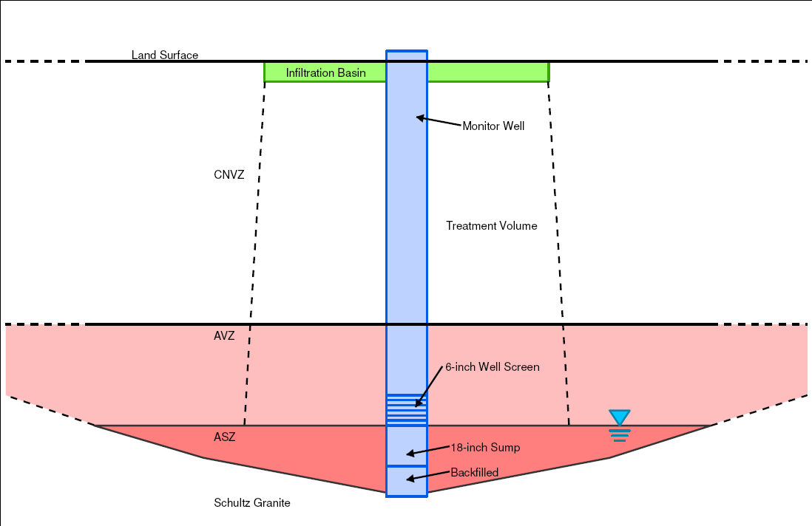
Acidic Vadose Zone Test Schematic
MWVZ01
Treatment Volume
Circum-neutral Vadose Zone
CNVZ
pH > 6.5
Acidic Vadose Zone
AVZ
pH < 6.5
Bedrock

Slide 7
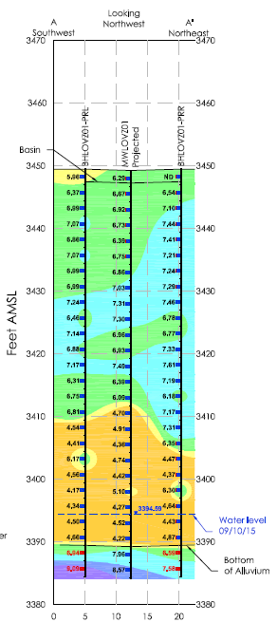
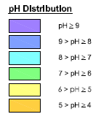
Pretest Sediment pH Cross Section
Looking
Upgradient
CNVZ
AVZ
ASZ
Water Level
Bedrock
Contact
Notes:
Review of the acidity in Live Oak

Slide 8
Site Layout
Legend
X
Totalizer
A – Mix Tank
B – Weir Tank
C – Basin
Well
Flow
Direction
Weir
Tank
(solids retention)
Groundwater
Flow
Basin
Gravity
Feed
N
Still Well
*Diagram not to scale
C
MWVZ01
MW
B
Mix Tank
Neutral Water
Pump
A
Milk of Lime

Slide 9
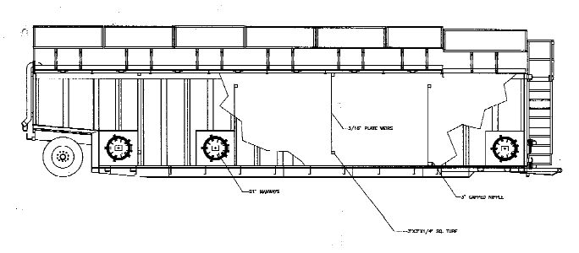
Weir Tank Schematic
FLOW
In
Out
Solids trapped behind weir

Slide 10
Test Results
Implementability
mix near-solubility lime solution
control solids
avoid application facility/aquifer formation damage
Effectiveness
raise pH
reduce metals concentrations

Slide 11
Test Results
Implementability
mix near-solubility lime solution
control solids
avoid application facility/aquifer formation damage
Effectiveness
raise pH
reduce metals concentrations

Slide 12
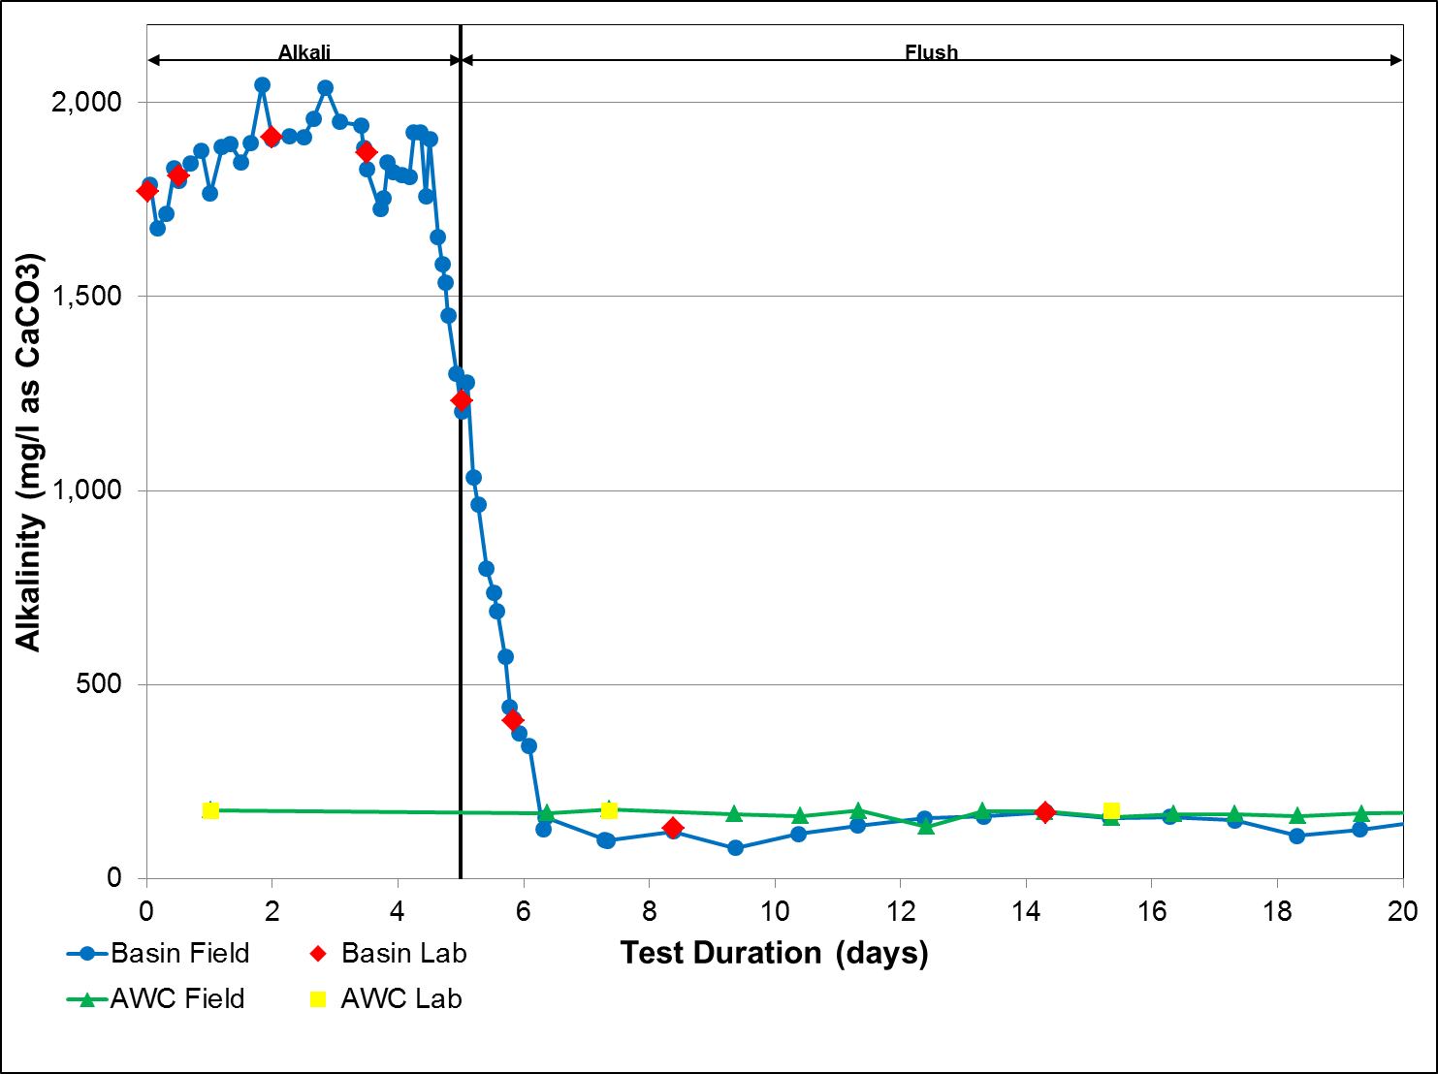
Alkalinity
Average 1,857 mg/l as CaCO₃
NWF Field
NWF Lab

Slide 13
Test Results
Implementability
mix near-solubility lime solution
control solids
avoid application facility/aquifer formation damage
Effectiveness
raise pH
reduce metals concentrations

Slide 14
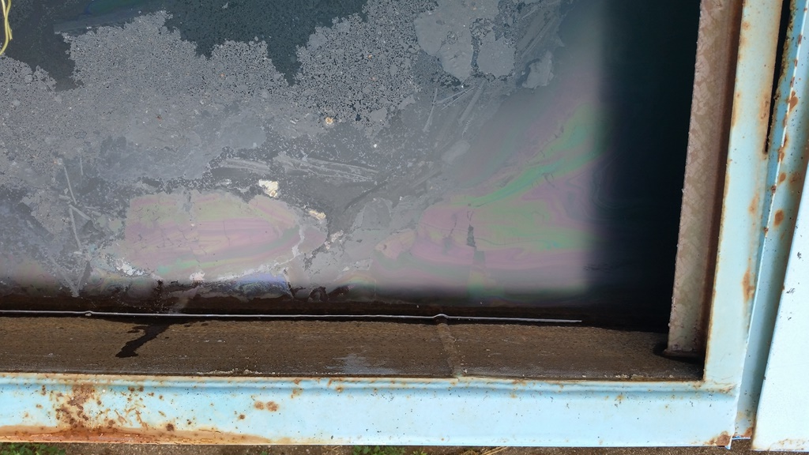
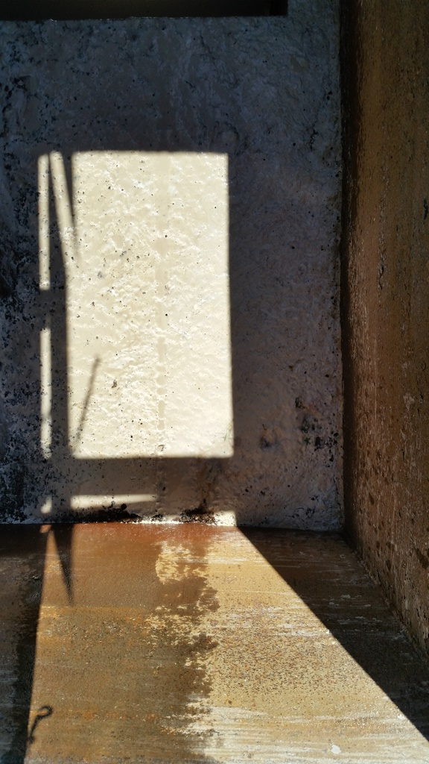
SOLIDS CONTROL – WEIR TANK
During Lime Application
Post Neutral Flush

Slide 15
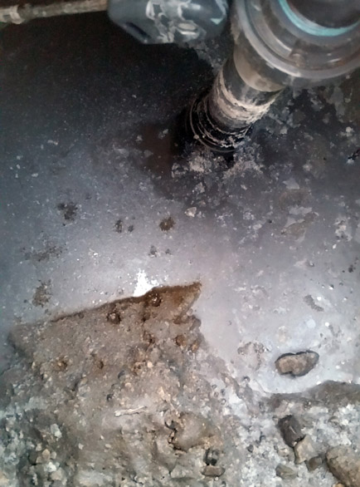
SOLIDS CONTROL – BASIN DURING ALKALI APPLICATION

Slide 16
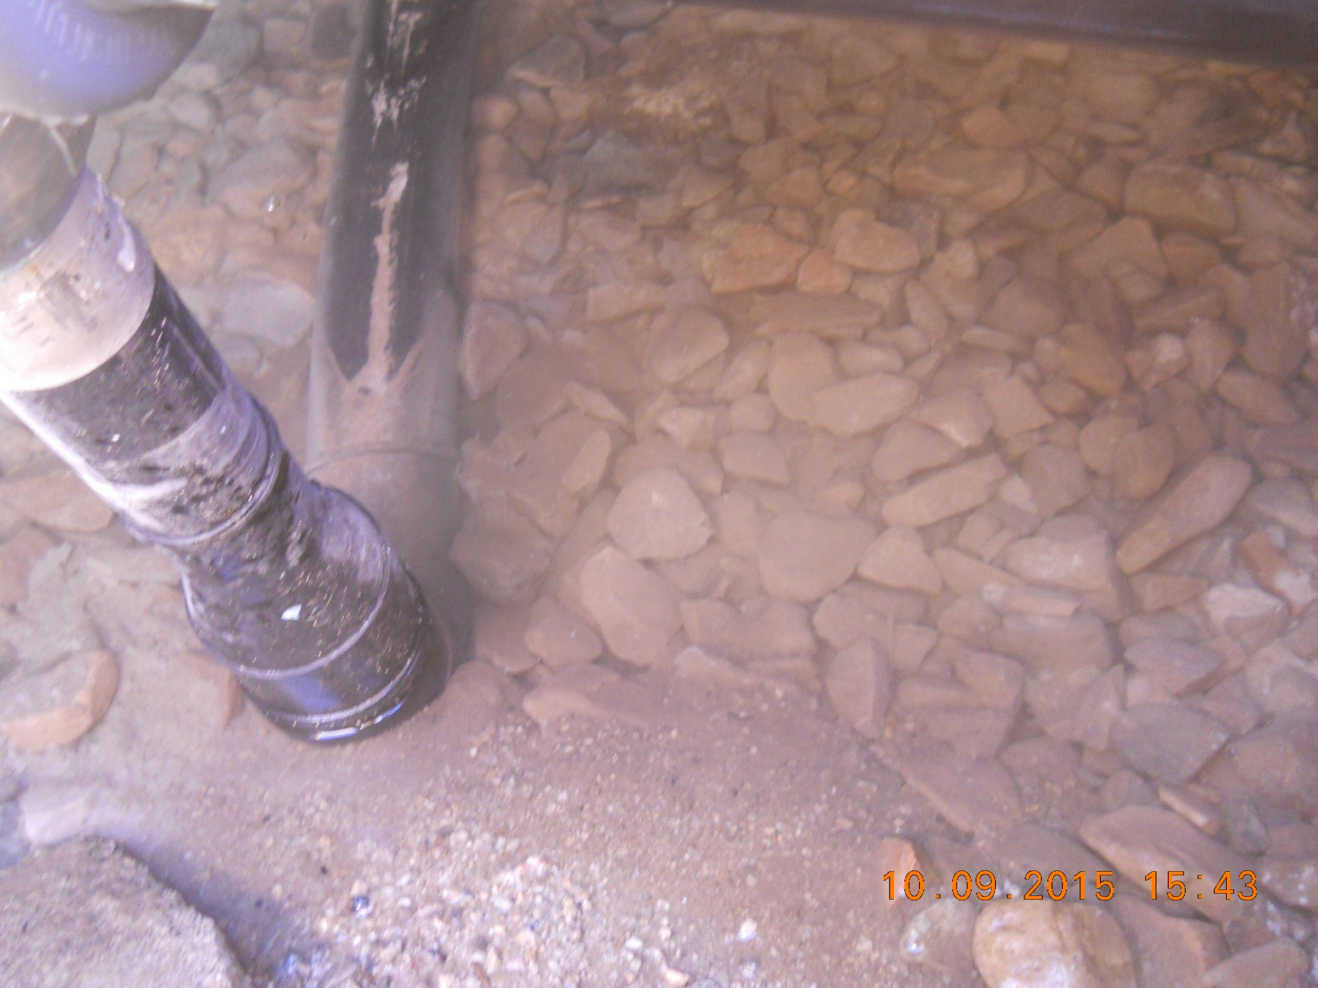
SOLIDS CONTROL – BASIN DURING NEUTRAL WATER FLUSH

Slide 17
Test Results
Implementability
mix near-solubility lime solution
control solids
avoid application facility/aquifer formation damage
Effectiveness
raise pH
reduce metals concentrations

Slide 18
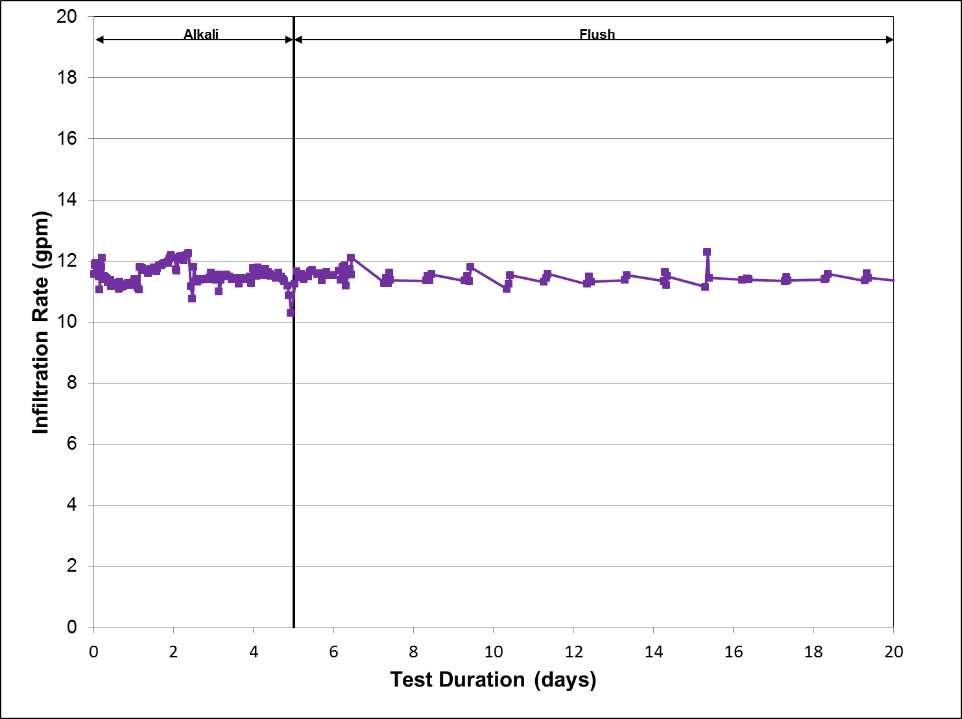
Infiltration Rate
Average 11.5 gpm

Slide 19
Test Results
Implementability
mix near-solubility lime solution
control solids
avoid application facility/aquifer formation damage
Effectiveness
raise pH
reduce metals concentrations

Slide 20
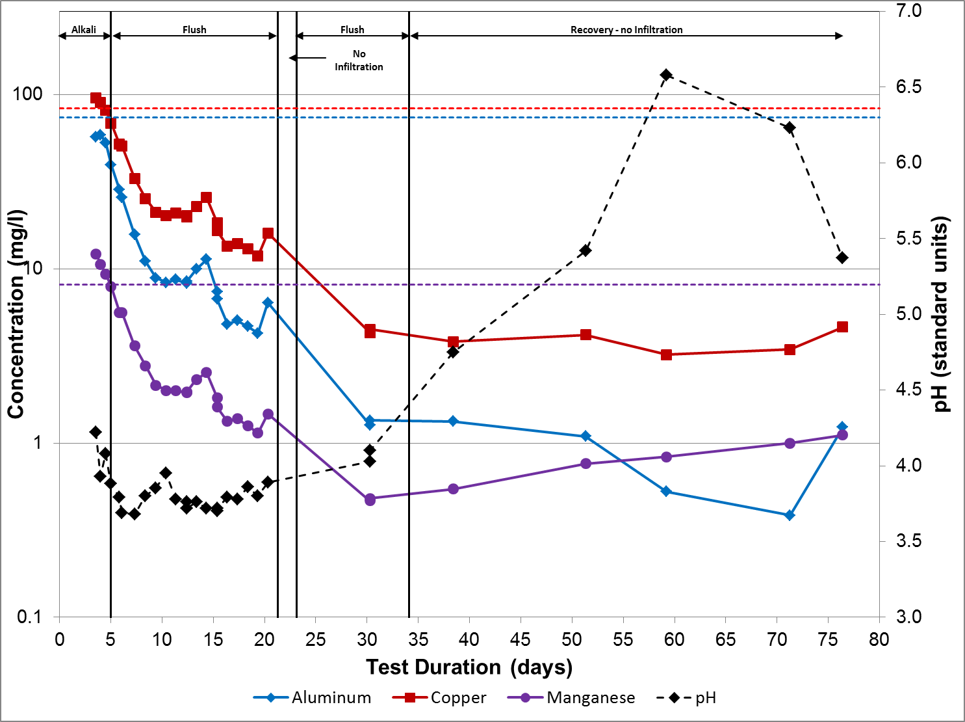
Groundwater Quality
Metals concentrations drop by > 90%
pH > 5.3 for 30 days

Slide 21
Test Summary
Implementability
Lime solutions near 90% solubility were efficiently mixed with a readily available rental mix tank
Calcite precipitates were effectively controlled using a readily available rental weir tank
Lime applied continuously at a rate of 11.5 gpm for 5.14 days
No clogging of the infiltration basin
No formation damage
Basin alkalinity was 98.2% of mix tank alkalinity

Slide 22
Test Summary
Effectiveness
Raised aqueous pH at base of treatment volume for >30 days
maximum pH of 6.58
Aqueous Al, Cu, and Mn concentrations decreased by >90%
remained at low levels through end of test (45 days)

